Slide 1

MINOR PROJECT
DEPARTMENT OF ELECTRONICS & COMMUNICATION ENGINEERING

Slide 2
An IoT-Enabled Fetal Health Monitoring During Pregnancy

Slide 3
Lavanya K (927621BEC101)
GUIDED BY
Mrs.M.Sentamilselvi [AP/ECE]

Slide 4
INTRODUCTION
Movement of the fetal and some important parameters such as Heartbeat rate, and temperature for the women are measured using various types of sensors. The measured parameters are transmitted by way of IOT and it is displayed in the mobile phone.

Slide 5
INTRODUCTION CONTD.
In the developing countries most of the peoples are lived in the rural areas and medical systems are not amalgamated for sharing information. mostly, the pregnant women are unable to do their normal checkups at the starting time of pregnancy time and this cause higher death count in case of newborn and perental in the rural areas as well as in urban also. Due to this situation, the women are facing an immense medical issue.

Slide 6
Heart rate sensor
Fetal heart rate monitoring is a procedure used to evaluate the well-being of the fetus by assessing the rate and rhythm of the fetal heartbeat.
Fetal heart rate monitoring uses a device to listen to or record the fetal heartbeat through the mother's abdomen.
Fetal Heart rate monitoring is measured by heart beat sensor

Slide 7
MEMS sensor
MEMS sensor to monitor fetal activity, and therefore fetal health.
These sensors are used to detect as well as measure the pressure and vibration
Temperature sensor
Temperature sensor is used to monitor the temperature. These values show the temperature of a fetal health

Slide 8
GSM module
A GSM modem is a device which can be either a mobile phone or a modem device which can be used to make a computer or any other processor communicate over a network
It can be connected through serial, USB or Bluetooth connection or with cloud

Slide 9
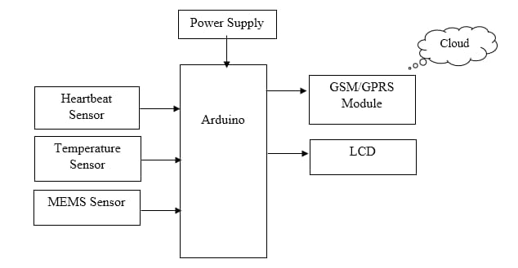
APPLICATION WORKFLOW

Slide 10
CONCLUSION
The main objective of this project is to monitor health parameters of Pregnancy women continuously for treating her with more care

Slide 11


